Slide 1
Software Development Models

Slide 2
Overview of This Lecture
Software Development Models
  Waterfall Model
  Evolutionary Models
  Incremental Model
  Spiral Model
  Unified Process

Slide 3
Software Development Models
High level, abstract representation of software development (software process):
  Specification.
  Development.
  Validation.
  Evolution.
Theoretical framework that is usually extended and adapted in real world application.
Two Generic Models:
  Waterfall Model.
  Evolutionary Model.

Slide 4
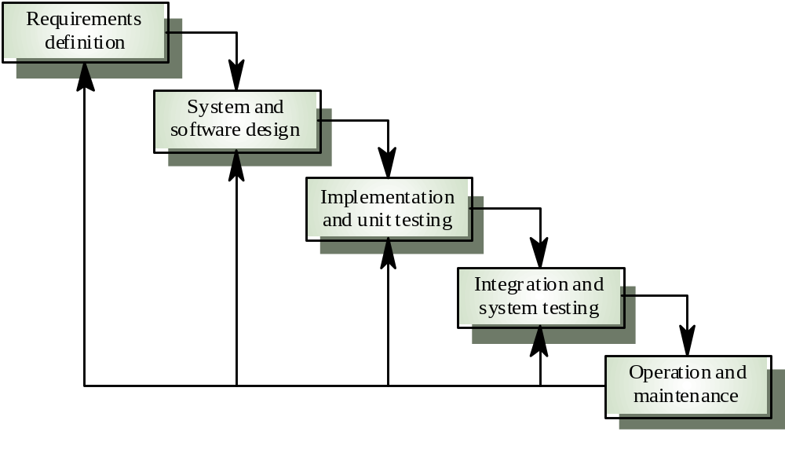
Waterfall Model
The earliest software development model (Royce, 1970).

Slide 5
Waterfall Model
Defined a number of phases, e.g., “requirement phase”, “design phase”, etc.
The phases correspond to the four stages of the fundamental software process activities (lecture 1).
Assumption behind the model:
  a phase takes place in sequence to another.
  each activity is completed before the next starts.

Slide 6
Waterfall Model
In theory:
  Each phase produces documents that are:
    Verified and validated.
    Assumed to be complete.
  Each phase depends on the documents of the previous stage to proceed → it has to wait for the completion of previous stage.
In practice:
  The phases overlap and feedback to each other (see the feedback arrow in the diagram).

Slide 7
Waterfall Model: Advantages
Tangible products (the various documents) at the end of every phases → good to measure progress.
Intuitive, sensible and general purpose:
  Emphasize planning before action.
  Recommend a top-down perspective. See the big picture before zooming down.

Slide 8
Waterfall Model: Problems
Specification is frozen early, because:
  It is costly and time consuming.
  Later stages can be carried out.
Cannot adapt to changing or incorrect specification:
  Ignore or code around.
  Does not meet user requirement.
Testing at the very end of development:
  Work or die situation.

Slide 9

Waterfall Model: Observations
Process stages can be iterative.
Flexibility in coping with changing specification.
Early and frequent validation of software system.
The later models are designed in response to these observations.

Slide 10
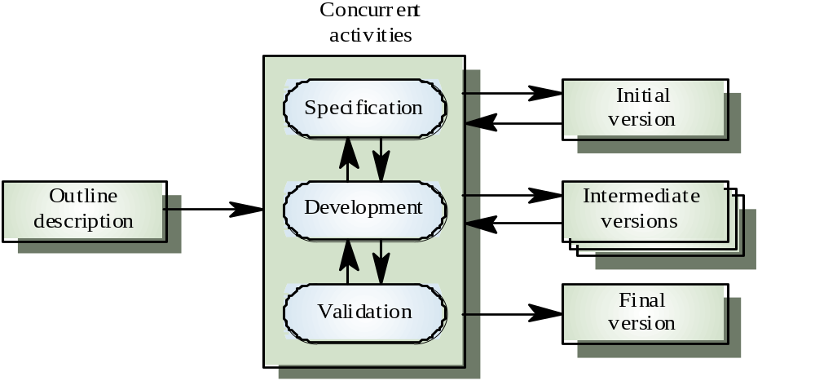
Evolutionary Model
Evolves an initial implementation with user feedback → multiple versions until the final version.

Slide 11
Evolutionary Model
Two fundamental types:
  Exploratory Development:
    Explores the requirement and delivers a final system.
    Starts with something that is understood and evolves by adding new features proposed by customers.
  Throwaway prototyping:
    Understands the requirement and develop a better requirement definition.
    Experimenting with poorly understood requirement.
    Usually develops User Interface (UI) with minor or no functionality.

Slide 12
Evolutionary Model: Advantages
Customer involvement in the process:
  More likely to meet the user requirement.
Early and frequent testing:
  More likely to identify problems.
  Lower risk.
Suitable for small to medium sized system.

Slide 13
Evolutionary Model: Problems
The process is intangible:
  No regular, well-defined deliverables.
The process is unpredictable:
  Hard to manage, e.g., scheduling, workforce allocation, etc.
Systems are poorly structured:
  Continual, unpredictable change tends to corrupt the software structure.
  Can cause major problems during software evolution.
Systems may not even converge to a final version.
  No strategy to gauge or solve this problem.

Slide 14
Incremental Model
Combine the advantages of Waterfall and Evolutionary Model.
Requirements Outline
Split into increments
Design System Architecture
Develop Increment
Validate Increment
Integrate Increment
Validate System
Final System

Slide 15
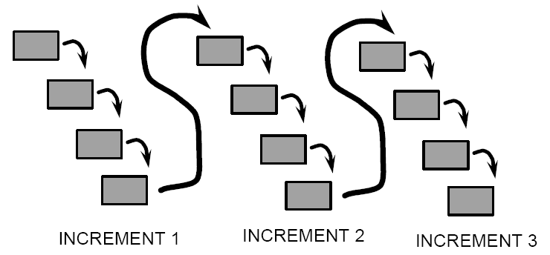
Incremental Model
Each increment is a mini-waterfall.

Slide 16
Incremental Model
Prioritizes the services to be provided by the system.
Maps these requirements to Increment based on priority.
Freezes requirement for the current Increment.
  Requirements for the later increments can evolve concurrently.
Each Increment release is a working system:
  Allows user to experiment.
  Can be put into service right away.

Slide 17
Incremental Model: Advantages
Early utilization:
  the 1st increment satisfies the most critical requirement.
Early increments can serves as prototypes.
Lower risk of overall project failure.
Most crucial and basic services are implemented first → receives multiple testing throughout development.

Slide 18
Incremental Model: Problems
Hard to map requirement into small increments (< 20,000 lines of code).
Hard to define the basic services that are shared by all subsequent increments.
Popular variant:
  AGILE method:
    eXtreme Programming (XP)
    Not covered here.

Slide 19
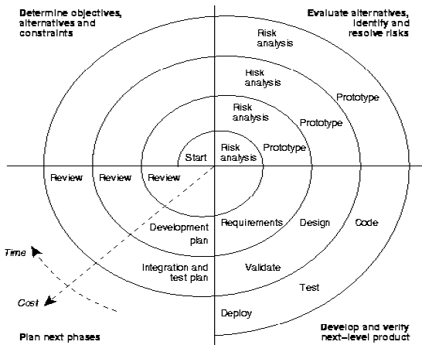
Spiral Model
Formalize the Evolutionary Model and avoid the management shortcomings.

Slide 20
Spiral Model
Process is represented as a spiral rather than as a sequence of activities with backtracking.
Each loop = One Iteration = A process phase.
Each Loop passes through 4 quadrants (90°):
  Objective Setting.
  Risk Assessment and Reduction.
  Development and Validation.
  Planning.
As loops move away from center → Time and Cost increase.

Slide 21
Spiral Model
Risk Driven:
  Explicitly identify risks for each iteration.
  Address the highest perceived risk.
Does not prescribe a fix process:
  Project Manager chooses the appropriate activity for each iteration base on progress and perceived risk.
Flexible:
  May resemble other process model depends on needs.

Slide 22
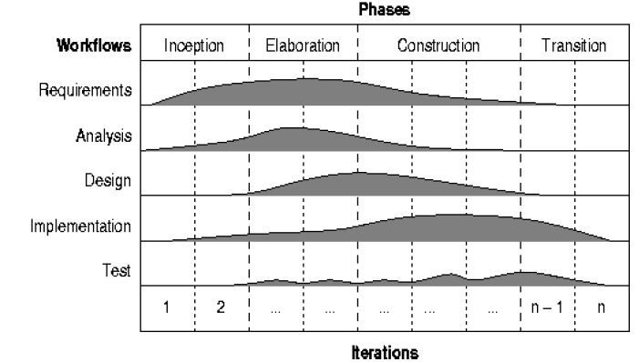
Unified Process
State of the art process, by learning from the history of previous software development processes.

Slide 23
Unified Process
Integrating two seemingly contradicting insights:
  Definitive activities and deliverables as in the Waterfall Model.
  Iterative and incremental processes.
A project is split into several phases:
  Each phase is split into several iterations.
  Each iteration consists of the traditional process activities, known as workflow.
Each workflow places different emphasis on the activities depending on the current iteration.

Slide 24
Unified Process: 4 Phases
Inception:
  Plan the project.
  Evaluate risk.
Elaboration:
  Understand problem domain.
  Design system architecture.
  Plan development.
Construction:
  Design, programming and test.
Transition:
  Moving system from developer to user environment.
  Acceptance testing, release of full system.

Slide 25
Other Process Models
Formal System Development:
  Transforms a mathematical based specification through different representation → executable program.
  Program correctness is easy to demonstrate, as the transformations preserve the correctness.
Reuse-Oriented Development:
  Concentrates on integrating new system with existing components/systems.
  Growing rapidly as development cost increase.
Aspect-Oriented Development.
Agent-Oriented Software Development.

Slide 26
Summary (1)
Waterfall Process Model:
  Development activities in a linear fashion.
  Requirements to freeze very early in development.
  Testing very late in the process.
Evolutionary Process Model in response to iterative nature of development:
  Use of prototyping.
  Requirements evolve with users’ feedback.

Slide 27
Summary (2)
Incremental Process Model in response to incremental nature of development:
  Delivery in increments.
  Allows prioritizing risks in development.
  Allows different process models for different increments.

Slide 28
Summary (3)
Spiral Model:
  Addresses incremental and iterative nature of development.
  Allows risk evaluation at every phase.
  Expensive process.
  Allows use of multiple process models.
Unified Process:
  Incorporates best industry practices.
  Extensive use of UML models.
  Allows iteration of workflows.

